Slide 1
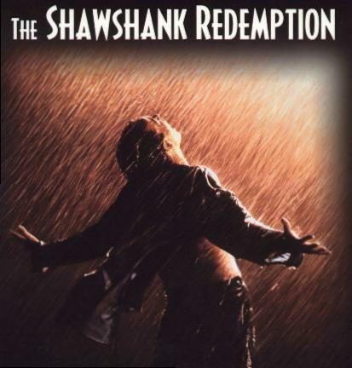
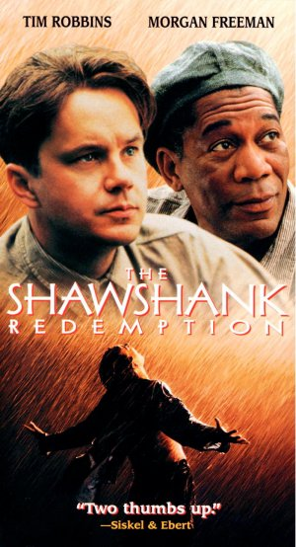
The Shawshank Redemption
Hong Zhang

Slide 2
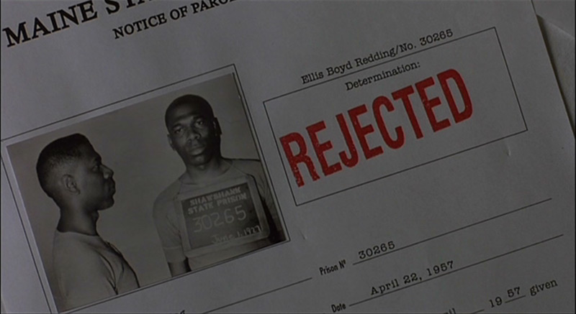
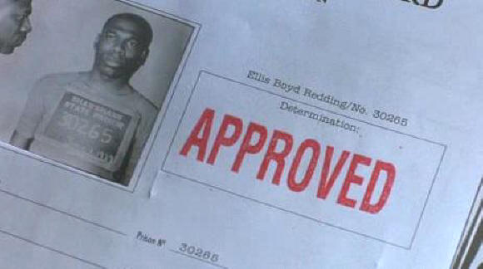
Theme
Institutionalization
Many prisoners have been in the prison for so long that they have been institutionalized, which means the only life that they know is the one within the prison walls.

Slide 3
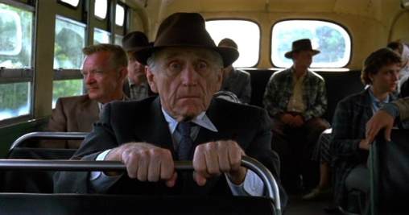
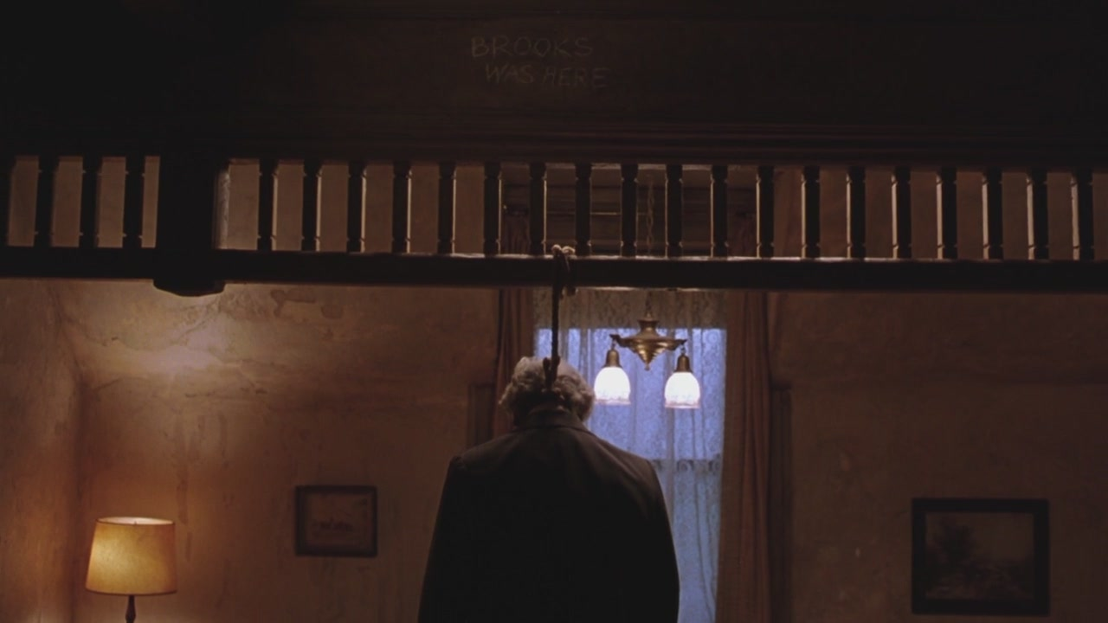
Theme
Institutionalization
Ex: Brooks lived most of his life in the prison, so when released he does not know how to live in the outside world. Things have changed so much while he was in prison and he even thinks of crimes he could commit in order to be thrown back into prison. He eventually commits suicide because he cannot handle life in the real world.

Slide 4
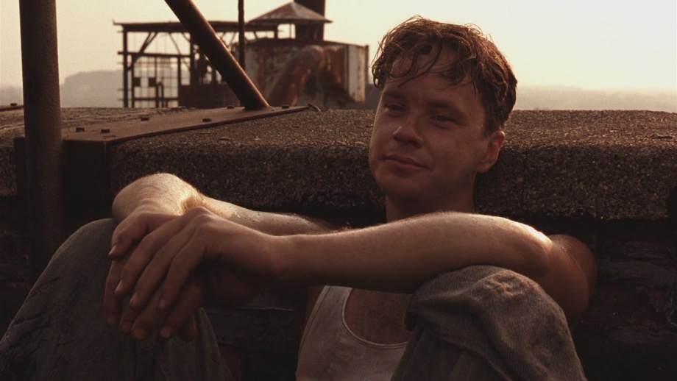
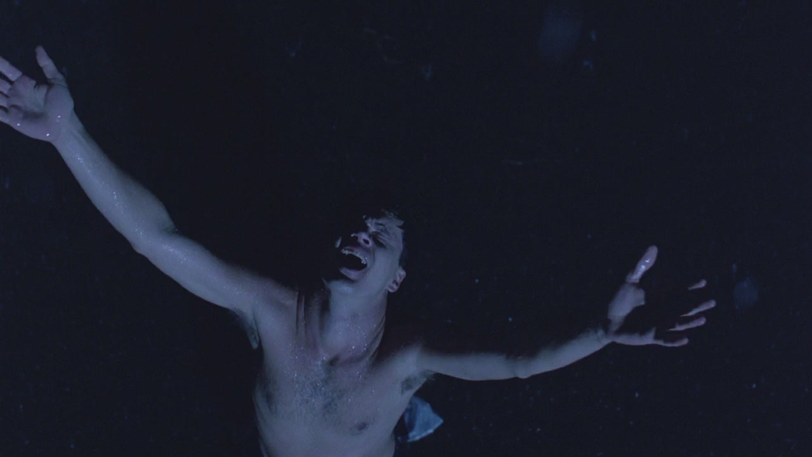
Theme
Hope
The Power of Hope: drive the inmates and gives them the will to live. Andy’s drive to maintain his own sense of self-worth and freedom is what prevents him from dying of frustration in solitary confinement.

Slide 5
The Rooftop Scene
Colour/ Lighting
Bright lighting and colour symbolises freedom
The guard’s faces are in shadow while the inmates are working.
Grass outside the prison is bright green – this shows a juxtaposition of the two settings – the inside and the outside
Prisoners can see green from the rooftops (hope, freedom) contrasted with the grey walls of the prison walls and grounds (institutionalisation, power corruption)
Sun shines on the inmates’ faces while they drink beer – freedom and the guards are in shadow in the distance with the prison walls behind them.
Can see lots of blue sky in the background, almost to the horizon, inmates feel a sense of freedom on the rooftops.

Slide 6
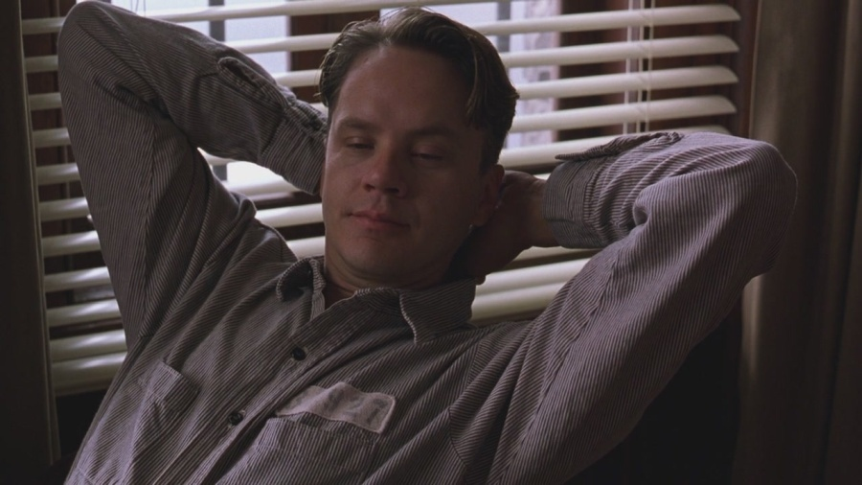
Aria over the Loudspeaker
Camera shot
A medium shot reveals Andy has the same look on his face as in the ‘Rooftop Scene’. He is allowing them to have some freedom again.

Slide 7
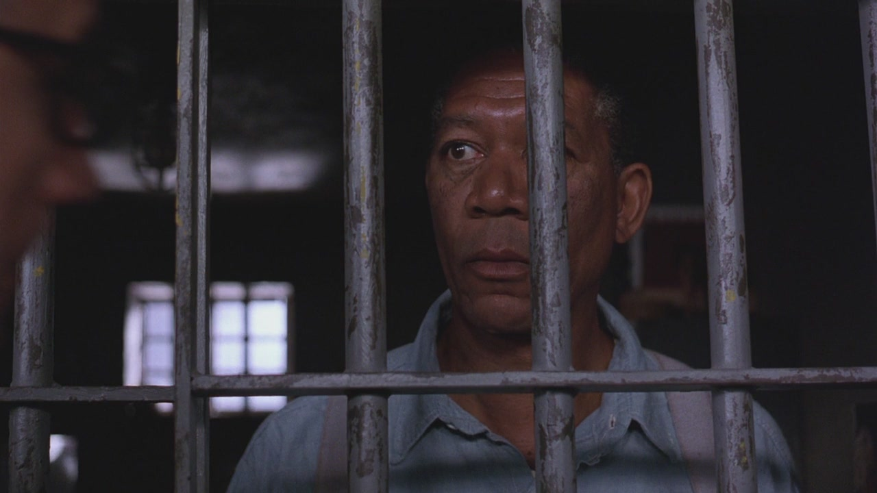
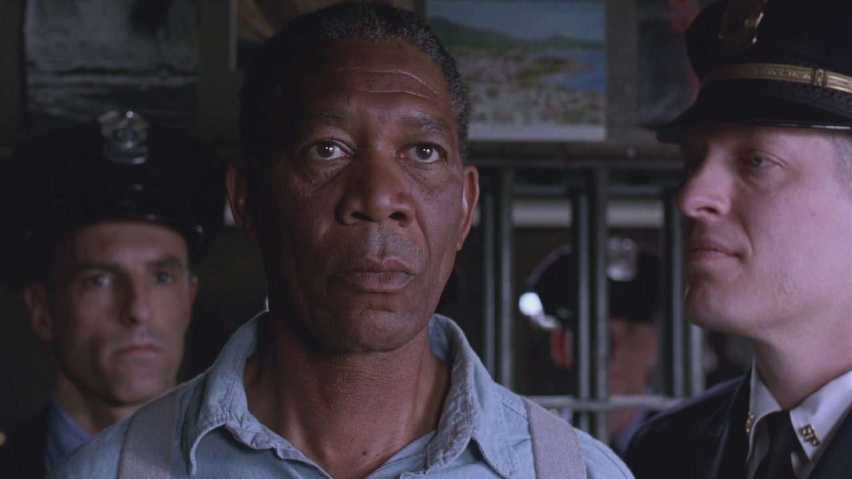
Final Scenes
Voiceover--Red
The voiceover is important because we can make links and Red points them out. He also give just cause for Andy’s actions. He is our guide on this journey – the story of Andy’s life in Shawshank.

Slide 8
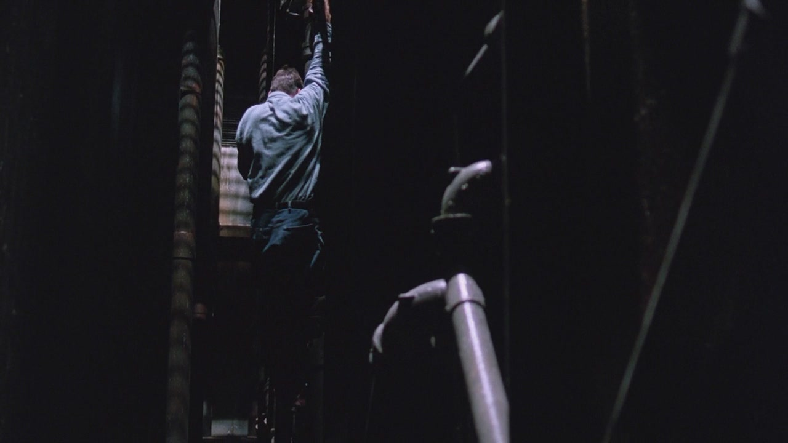
Final Scenes
Music
The way that it is built up and speeds up when the warden finds the escape hole that Andy climbed through, adds a scary fell to the scene. This is because it makes the audience feel tense and hooked in the story, and as the music starts to race, so does their heart beat causing them to be on the edge of their seats.

Slide 9
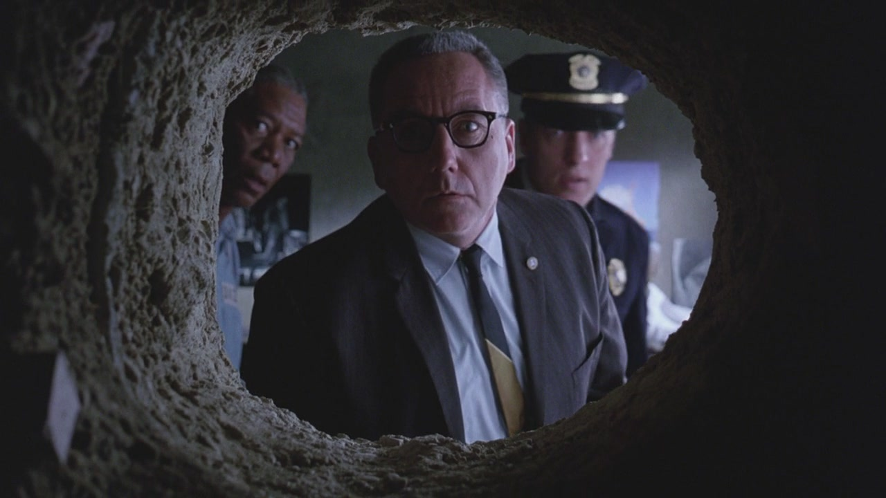
Final Scenes
camera shot--worm’s eye
This adds tension because the audience can see the mere size of the hole that Andy climbed through.
It is also quite intimidating because it makes the warden seem much bigger than he is, because the camera is looking up at him. This adds tension because it makes the audience feel that he is big and strong and who knows what he is capable of.

